Slide 1
Requirements Analysis

Slide 2
Requirements Modelling
Requirements Analysis
Scenario Based Modelling
UML Models
Data Modelling,
Class-Based Modelling
Requirements Modelling For Webapps

Slide 3
Requirements analysis
specifies software’s operational characteristics
indicates the software's interface with other system elements
establishes constraints that software must meet
Allows the software engineer/analyst/modeler to:
elaborate on basic requirements established during earlier requirement engineering tasks
build models to depict
user scenarios
functional activities
system and class behavior
the flow of data as it is transformed
System Description
Analysis Model
Design Model

Slide 4

Analysis Rules of Thumb
focus on requirements that are visible within the problem or business domain.
add to an overall understanding of software requirements
provide insight into the information domain, function and behavior of the system.
Delay consideration of infrastructure and other non-functional models until design.
Minimize coupling throughout the system.
Be certain that the analysis model provides value to all stakeholders.
Keep the model as simple as it can be.

Slide 5
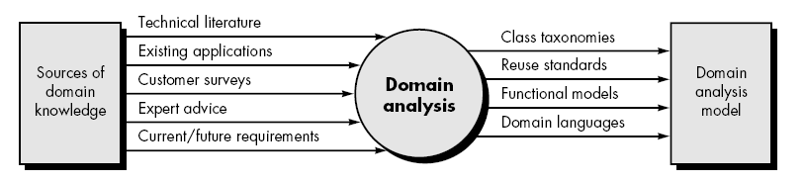
Domain analysis
is the process by which a software engineer learns background information.
Define the domain to be investigated.
Collect a representative sample of applications in the domain.
Analyze each application in the sample.
Develop an analysis model for the objects.

Slide 6
Requirements Modeling Approaches
Structured analysis -- Data & Processes that transform the data
Data objects →attributes and relationships.
Processes are modeled to show how they transform data as data objects flow through the system.
Object-Oriented analysis -- focuses on the definition of classes and the manner in which they collaborate with one another.

Slide 7
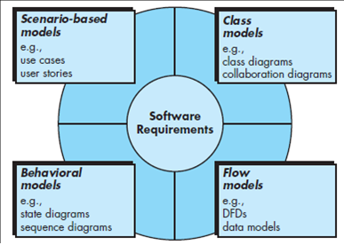
Elements of Requirements Analysis
Depict how the user interacts with the system and the sequence of activities that occur as the software is used
Objects that the system will manipulate, the operations, relationships, and the collaborations
System as an information transform, depicting how data objects are transformed as they flow through various system functions
External events change the state of the system or the classes that reside within it

Slide 8
SCENARIO-BASED MODELING
Creating a Preliminary Use Case: What to write about? - inception and elicitation
Refining a Preliminary Use Case - primary scenario is evaluated by asking questions
Writing a Formal Use Case: a use case involves a critical activity or describes a complex set of steps with a significant number of exceptions
UML MODELS THAT SUPPLEMENT THE USE CASE
Activity Diagram - Supplements the use case by providing a graphical representation of the flow of interaction within a specific scenario
Swimlane Diagrams - represent the flow of activities described by the use case and at the same time indicate which actor or analysis class has responsibility for the action described by an activity rectangle.

Slide 9
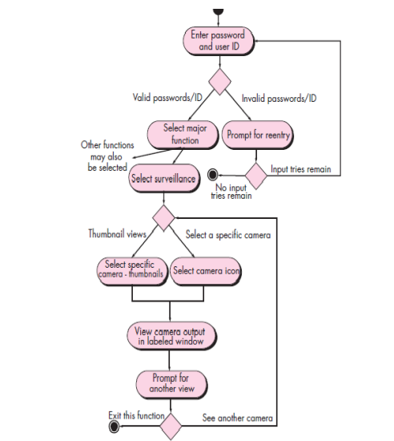

Slide 10
DATA MODELING CONCEPTS

Slide 11
DATA MODELING CONCEPTS
Data Objects
representation of composite information that must be understood by software.
an external entity with attributes. encapsulates data only & no reference to operations that act on the data.
Data Attributes
Data attributes define the properties of a data object
They name an instance of the data object,
They describe the instance
They make reference to another instance in another table.
one or more of the attributes - an identifier
Relationships
Data objects connected to one another in different ways
If there is a need to create, extend or interface with a database
if complex data structures must be constructed and manipulated
entity-relationship diagram (ERD)

Slide 12
CLASS-BASED MODELING
represents the objects that the system will manipulate,
the operations that will be applied to the objects to effect the manipulation,
relationships between the objects, and
the collaborations that occur between the classes that are defined.
Identifying Analysis Classes
External entities that produce or consume information to be used by a computer-based system.
Things (e.g., reports, displays, letters, signals) that are part of the information domain for the problem.
Occurrences or events (e.g., a property transfer or the completion of a series of robot movements) that occur within the context of system operation.
Roles (e.g., manager, engineer, salesperson) played by people who interact with the system.
Organizational units (e.g., division, group, team) that are relevant to an application.
Places (e.g., manufacturing floor or loading dock) that establish the context of the problem and the overall function of the system.
Structures (e.g., sensors, four-wheeled vehicles, or computers) that define a class of objects or related classes of objects.
classes and objects,
attributes,
operations,
class responsibility collaborator (CRC) models,
collaboration diagrams, and packages

Slide 13
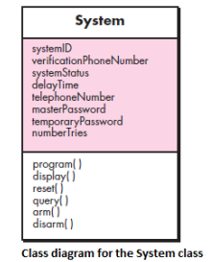
CLASS-BASED MODELING
Attributes
set of data objects that fully define the class within the context of the problem.
Attributes that define the class—clarify what is meant by the class in the context of the problem space.
To develop a meaningful set of attributes for an analysis class, select those “things” that reasonably “belong” to the class.
Operations
define the behavior of an object
(1) operations that manipulate data in some way.
(2) operations that perform a computation,
(3) operations that inquire about the state of an object,
(4) operations that monitor an object for the occurrence of a controlling event
classes and objects,
attributes,
operations,
class responsibility collaborator (CRC) models,
collaboration diagrams, and packages

Slide 14
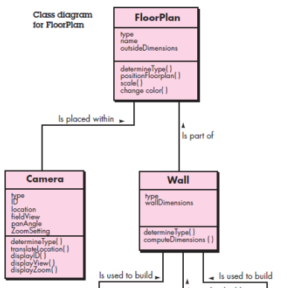
CLASS-BASED MODELING
class responsibility collaborator (CRC) models
identifying and organizing the classes that are relevant to system or product requirements
intent is to develop an organized representation of classes.
top -name of the class.
left -list the class responsibilities / the attributes and operations that are relevant for the class
right- collaborators/classes that are required to provide a class with the information needed to complete a responsibility.
classes and objects,
attributes,
operations,
class responsibility collaborator (CRC) models,
collaboration diagrams, and packages

Slide 15
CLASS-BASED MODELING
taxonomy of class types
Entity classes- extracted directly from the statement of the problem, represent things that are to be stored in a database and persist throughout the duration of the application.
Boundary classes – are used to create the interface that the user sees and interacts with as the software is used.
Controller classes - manage a “unit of work” from start to finish.
(1) the creation or update of entity objects,
(2) the instantiation of boundary objects as they obtain information from entity objects,
(3) complex communication between sets of objects,
(4) validation of data communicated between objects or between the user and the application.
classes and objects,
attributes,
operations,
class responsibility collaborator (CRC) models,
collaboration diagrams, and packages

Slide 16
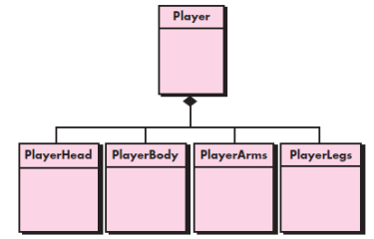
CLASS-BASED MODELING
Collaboration
(1) A class can use its own operations to manipulate its own attributes, thereby fulfilling a particular responsibility,
(2) a class can collaborate with other classes.
three different generic relationships between classes
(1) the is-part-of relationship,
(2) the has-knowledge-of relationship,
(3) the depends-upon relationship.
When a complete CRC model has been developed, stakeholders can review the model using the following approach
1. All participants in the review are given a subset of the CRC model index cards. Cards that collaborate should be separated
2. All use-case scenarios (corresponding use-case diagrams) should be organized into categories.
3. The review leader reads the use case deliberately.
4. When the token is passed, the holder of the Sensor card is asked to describe the responsibilities noted on the card.
5. If the responsibilities and collaborations noted on the index cards cannot accommodate the use case, modifications are made to the cards.
classes and objects,
attributes,
operations,
class responsibility collaborator (CRC) models,
collaboration diagrams, and packages

Slide 17
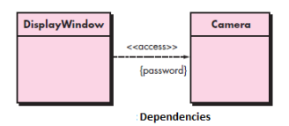
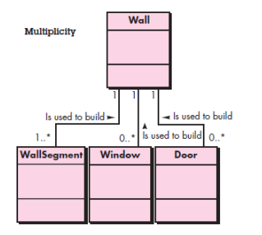
Associations and Dependencies
Two analysis classes are related to one another, much like two data objects may be related to one another.
“one or more” is represented using 1. .*, and “0 or more” by 0 . .*.

Slide 18
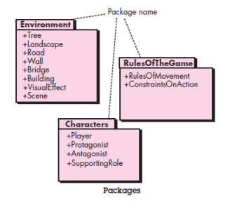
CLASS-BASED MODELING
classes and objects,
attributes,
operations,
class responsibility collaborator (CRC) models,
collaboration diagrams, and packages
plus sign preceding the analysis class name in each package indicates that the classes have public visibility and are therefore accessible from other packages
A minus sign indicates that an element is hidden from all other packages and
a # symbol indicates that an element is accessible only to packages contained within a given package.

Slide 19
REQUIREMENTS MODELING FOR WEBAPPS
Web development process must be agile, and analysis is time consuming
How Much Analysis Is Enough?
Size and complexity of WebApp increment.
Number of stakeholders
Size of the WebApp team.
Degree to which members of the WebApp team have worked together before
Degree to which the organization’s success is directly dependent on the success of the WebApp.
Requirements Modeling Input:
the information collected during the communication activity
anything from an informal e-mail to a detailed project brief complete with comprehensive usage scenarios and product specifications

Slide 20
REQUIREMENTS MODELING FOR WEBAPPS
Requirements Modeling Output:
Content model—identifies the full spectrum of content to be provided by WebApp. Content includes text, graphics and images, video, and audio data.
Interaction model—describes the manner in which users interact with WebApp.
Functional model—defines the operations that will be applied to WebApp content and describes other processing functions that are independent of content but necessary to the end user.
Navigation model—defines the overall navigation strategy for the WebApp.
Configuration model—describes the environment and infrastructure in which the WebApp resides.

Slide 21
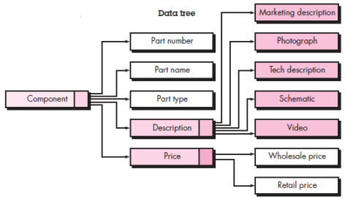
Content Model for WebApps
contains structural elements that provide an important view of content requirements for a WebApp
user-visible entities that are created or manipulated as a user interacts with the WebApp.
Examples: textual description of a product, an article describing a news event, an action photograph taken at a sporting event, a user’s response on a discussion forum, an animated representation of a corporate logo, a short video of a speech, or an audio overlay for a collection of presentation slides.
content objects might be stored as separate files, embedded directly into Web pages, or obtained dynamically from a database.
A data tree defines hierarchical relationships between content objects
that is composed of multiple content objects and data items

Slide 22
Interaction Model for WebApps
WebApps enable a “conversation” between an end user and application functionality, content, and behavior.
This conversation can be described using an interaction model that can be composed of one or more of the following elements:
(1) use cases,
(2) sequence diagrams,
(3) state diagrams
(4) user interface prototypes.

Slide 23
Functional Model for WebApps
Addresses two processing elements of the WebApp,
user-observable functionality that is delivered by the WebApp to end users --processing functions that are initiated directly by the user.
the operations contained within analysis classes that implement behaviors associated with the class -- manipulate class attributes and are involved as classes collaborate with one another to accomplish some required behavior
UML activity diagram can be used to represent processing details.

Slide 24
Configuration Models for WebApps
a list of server-side and client-side attributes.
Else, a variety of configuration complexities (e.g., distributing load among multiple servers, caching architectures, remote databases, multiple servers serving various objects on the same Web page) may have an impact on analysis and design.
The UML deployment diagram can be used in situations in which complex configuration architectures must be considered.

Slide 25
Navigation Modeling
Navigation modeling considers how each user category will navigate from one WebApp element to another.
Should certain elements be easier to reach (require fewer navigation steps) than others? What is the priority for presentation?
Should certain elements be emphasized to force users to navigate in their direction?
How should navigation errors be handled?
Should navigation to related groups of elements be given priority over navigation to a specific element?
Should navigation be accomplished via links, via search-based access, or by some other means?
Should certain elements be presented to users based on the context of previous navigation actions?
Should a navigation log be maintained for users?
Should a full navigation map or menu be available at every point in a user’s interaction?
Should navigation design be driven by the most commonly expected user behaviors or by the perceived importance of the defined WebApp elements?
Can a user “store” his previous navigation through the WebApp to expedite future usage?
For which user category should optimal navigation be designed?
How should links external to the WebApp be handled? Overlaying the existing browser window? As a new browser window? As a separate frame?

